Slide 1

Introduction to Prompt Engineering

Slide 2
“Prompt”
A prompt is a set of instructions or input given to a computer program to perform a specific task or generate a particular output.
In the context of our conversation, a prompt is the text or question you provide to me, guiding the direction of our discussion.
prompt in the context of prompt engineering refers to a clear and straightforward input or query given to a language model or natural language processing (NLP) system.
Natural language text describing the task that an AI should perform.

Slide 3
Language Models
A language model is a type of artificial intelligence model designed to understand and generate human-like text
--Artificial intelligence(Perform tasks requiring human-like intelligence)
It is trained on large datasets to predict the probability of a word or sequence of words given a context.
--Dataset (collection of data, used for analysis, research, or to train and test Artificial Intelligence Models)

Slide 4
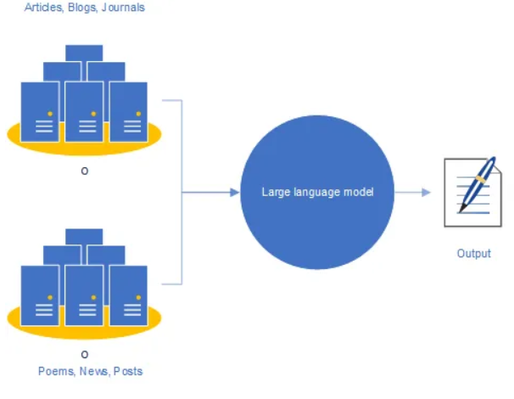
Language Model Applications
Language models have diverse applications, including
Text Generation: Creating coherent and contextually relevant text.
Machine Translation: Translating text from one language to another.
Text Summarization: Generating concise summaries of longer texts.
Question Answering: Providing relevant answers to user queries.
Chatbots: Enabling natural language interactions in conversational agents.

Slide 5
Prompt Engineering
"Prompt engineering" refers to the process of designing and formulating prompts or questions that encourage thoughtful and meaningful responses from individuals
A crucial skill for university students as it helps them engage with course material more deeply and express their understanding effectively.

Slide 6
Applications
Prompt engineering is used for different types of generative AI models:
text-based models (e.g., ChatGPT)
image generators (e.g., Midjourney)
code generators (e.g., Copilot).

Slide 7
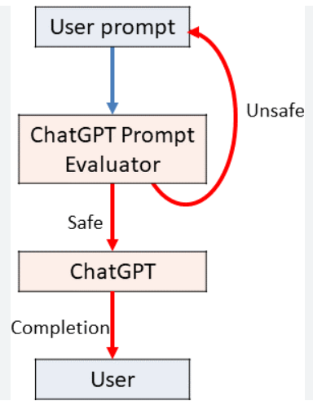
Introduction to Chat-GPT
ChatGPT operates based on a prompt-based approach.
The quality of the responses depends on the clarity and specificity of the prompts, as well as the context provided within the conversation

Slide 8
Tasks
List down more language models other than chat gpt and usage
Create a table using chat gpt in which columns name would be id,name
rollno, contact Number,Semester , discipline , Courses (records must be 20)

